Slide 1
Police Use of Force Data Analysis
Saeed Rafieepour

Slide 2
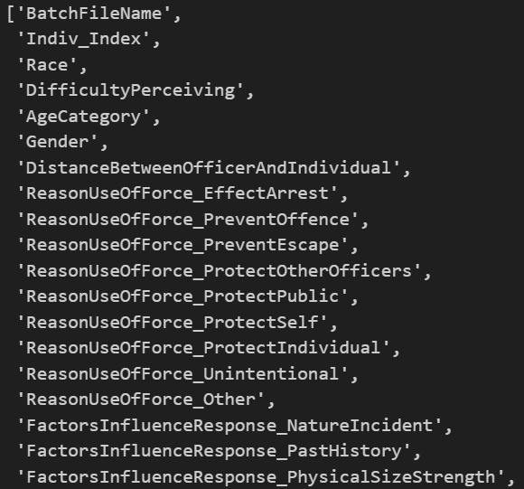
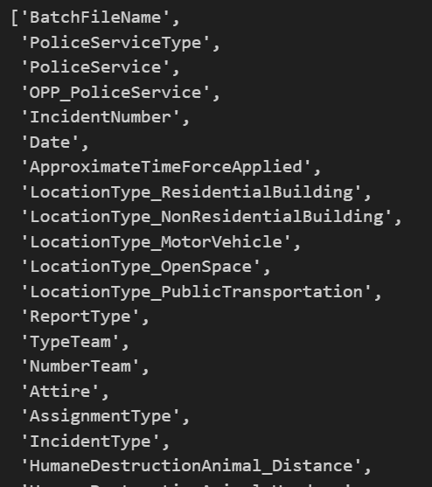
Data Source
Two datasets were provided in CSV format.
Dataset has 12,805 observations use of force in Ontario for 2023.
Main dataset has 64 features includes the main records and provides core information, at the report-level, on provincially reportable police use of force incidents that occurred in 2023.
Individual dataset has 112 features, and provides information about the individuals in respect of whom a Police Use of Force Report is completed.
Individuals
Main

Slide 3
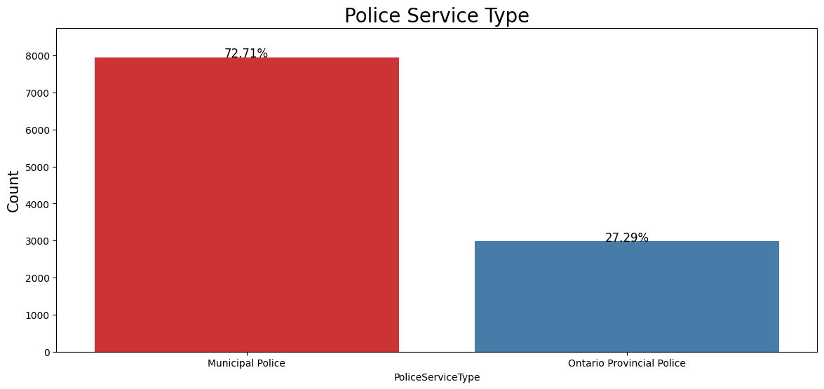
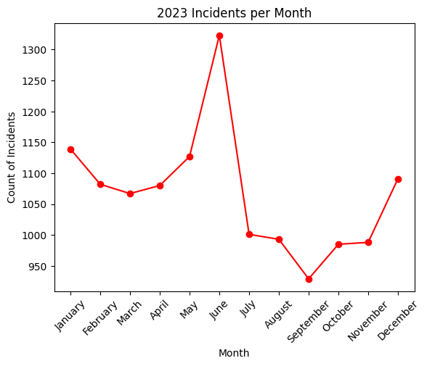
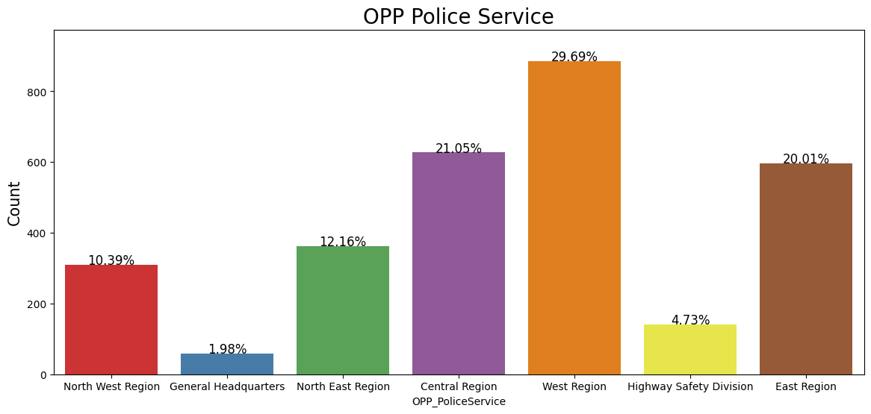
Spatio-Temporal Distribution

Slide 4
Types of Police Use of Force

Slide 5
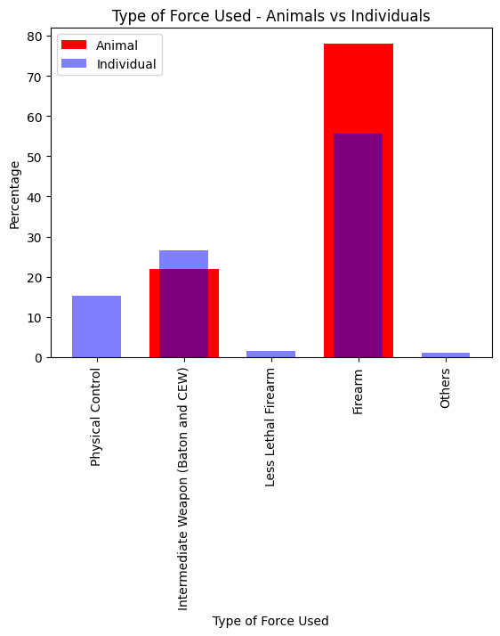
Type of Force for Individuals and Animals

Slide 6
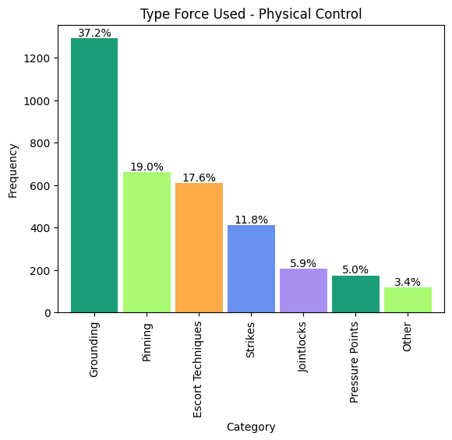
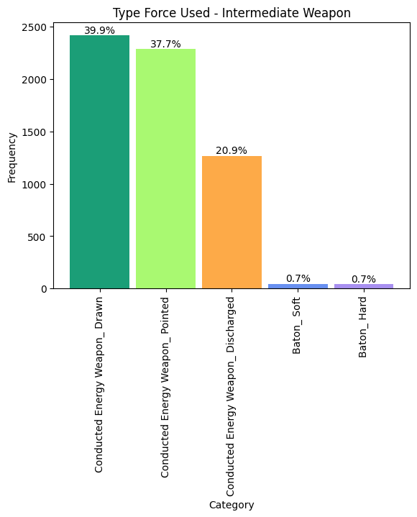
Breakdown of Type of Force for Individuals

Slide 7
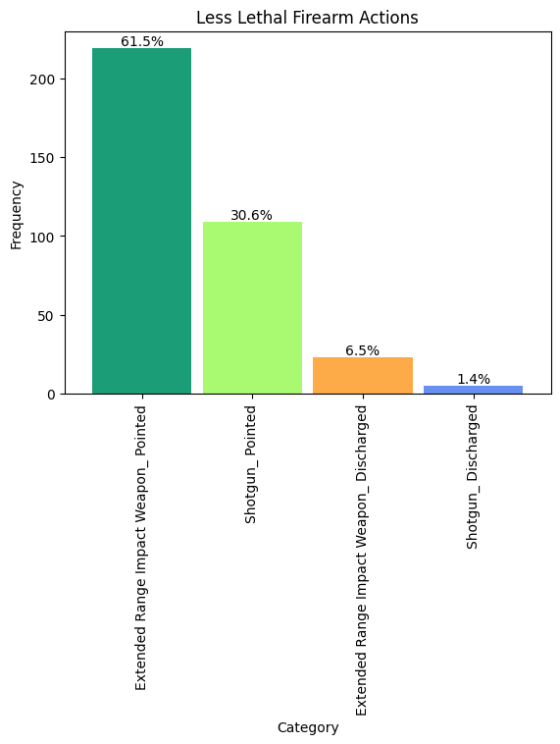
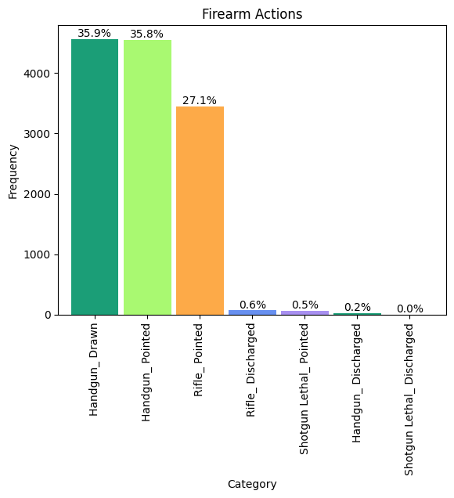
Breakdown of Type of Force for Individuals

Slide 8
Reasons for Use of Force

Slide 9
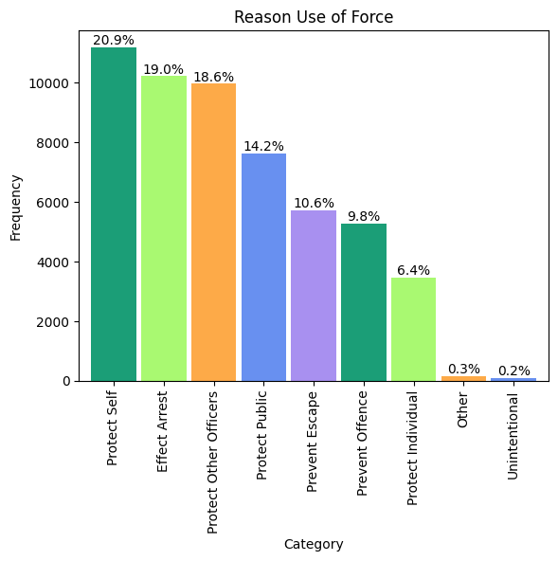
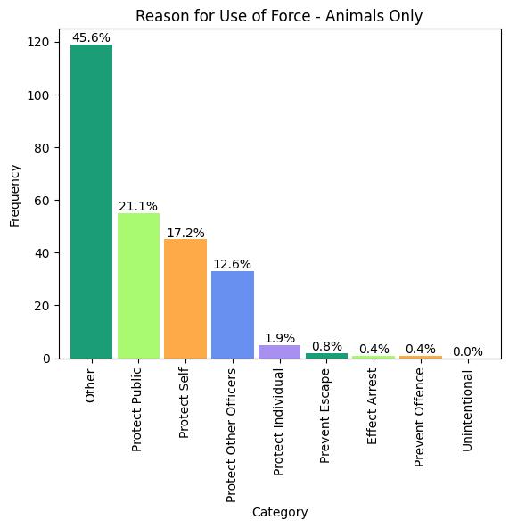
Reason for Use of Force

Slide 10
Officer’s Response

Slide 11
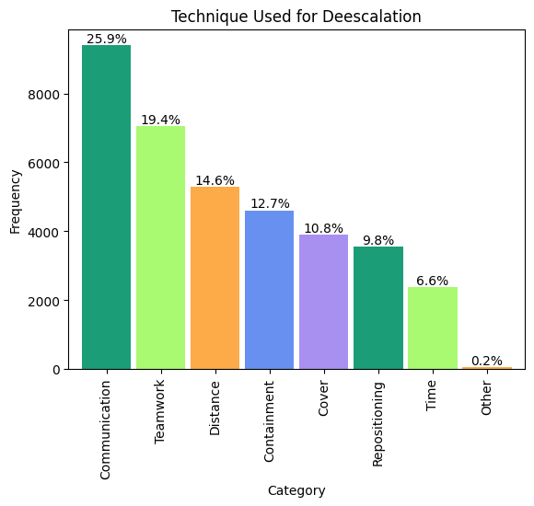
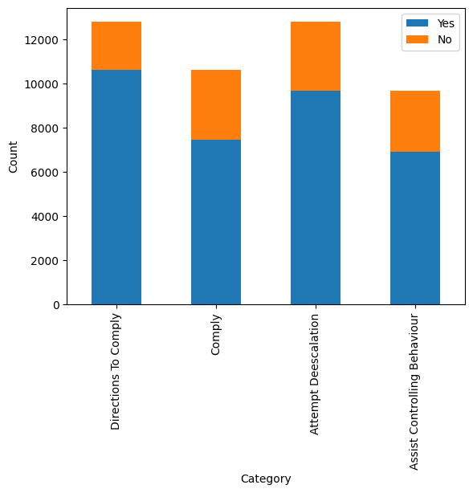
What is Officer Response to the Situation?

Slide 12
Demographic Factors

Slide 13
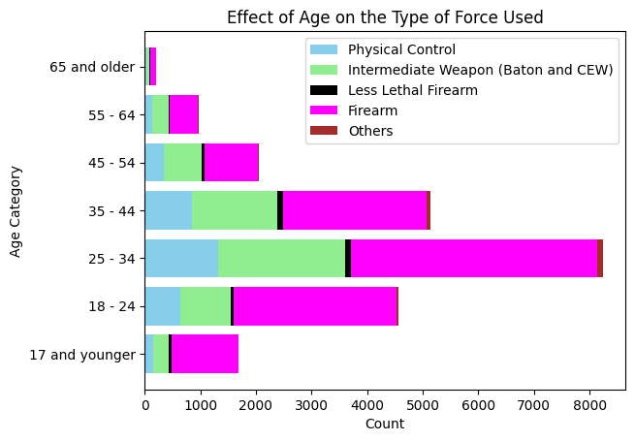
Type of Force vs Age Range

Slide 14
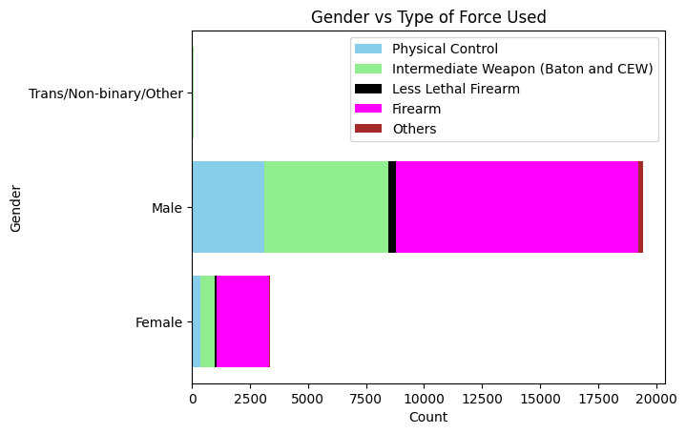
Type of Force vs Gender

Slide 15
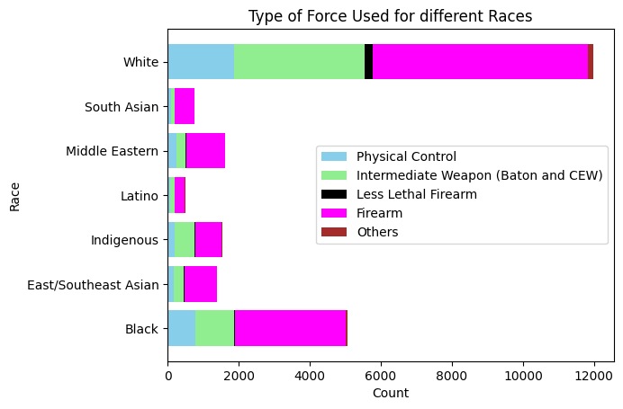
Type of Force vs Race

Slide 16
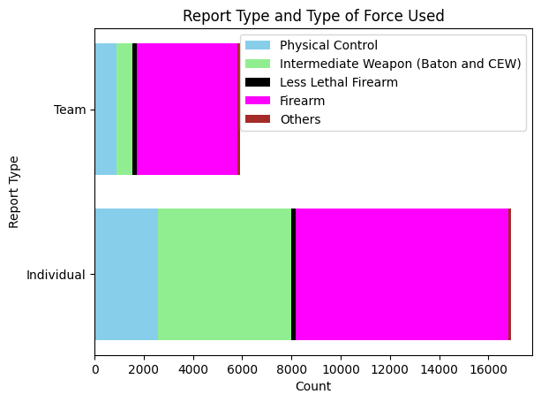
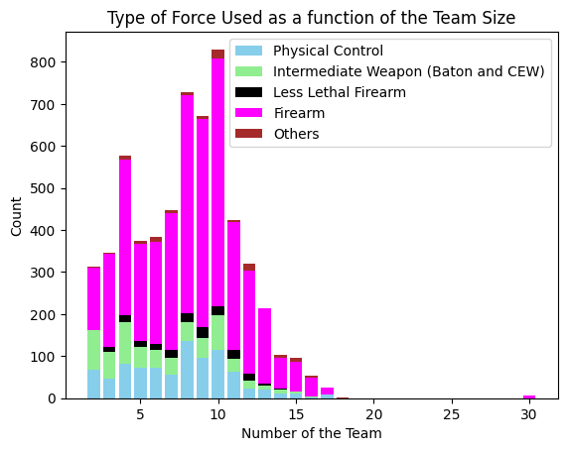
Individual or Team

Slide 17
Other Factors

Slide 18
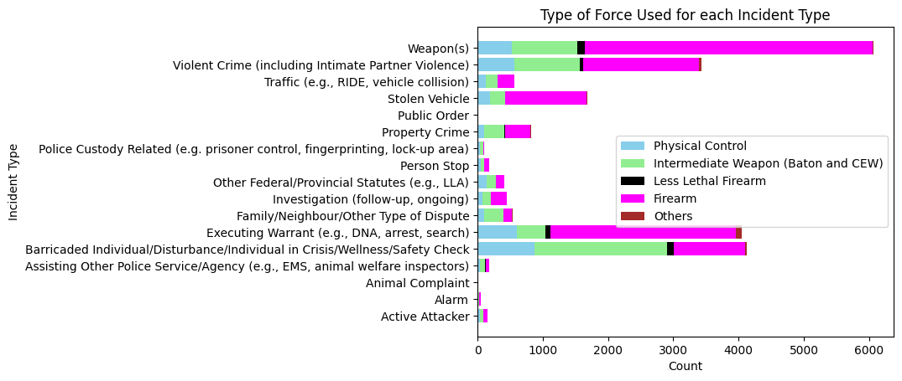
Type of Force vs Type of Incident

Slide 19
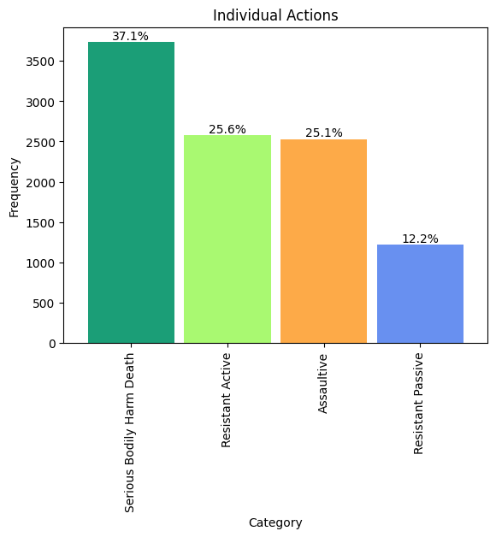
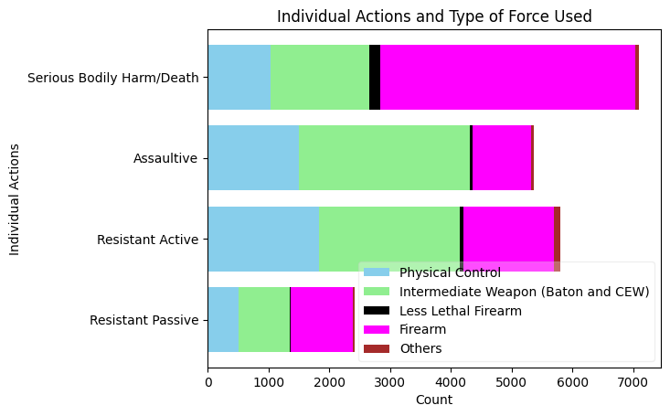
Individual Actions

Slide 20
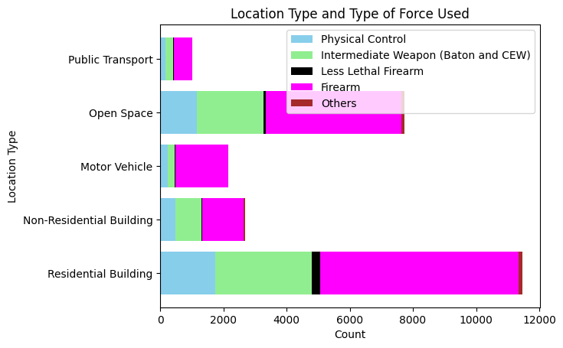
Type of Force vs Location of Incident

Slide 21
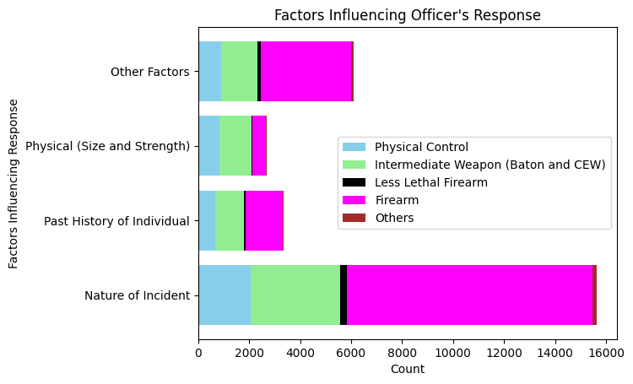
Factors Influencing Officer Response

Slide 22
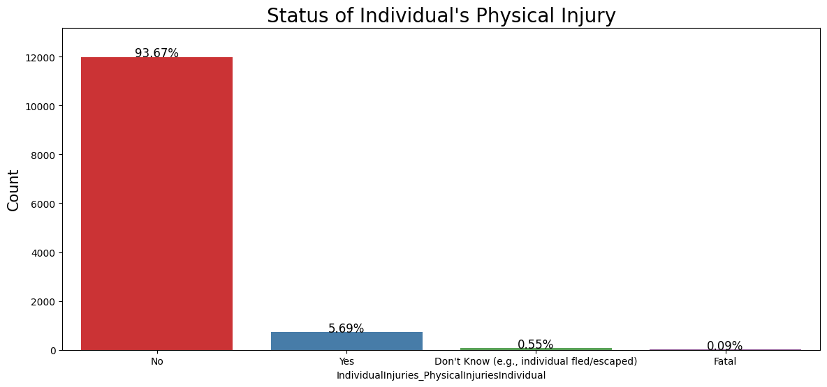
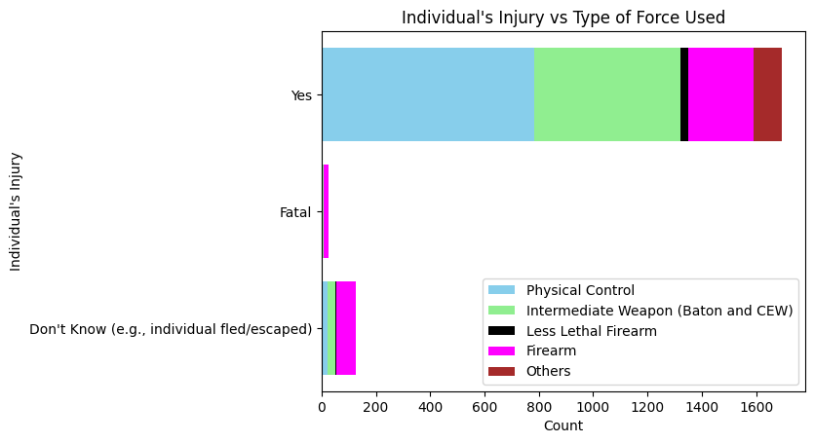
Individuals’ Injury and Type of Force Used

Slide 23
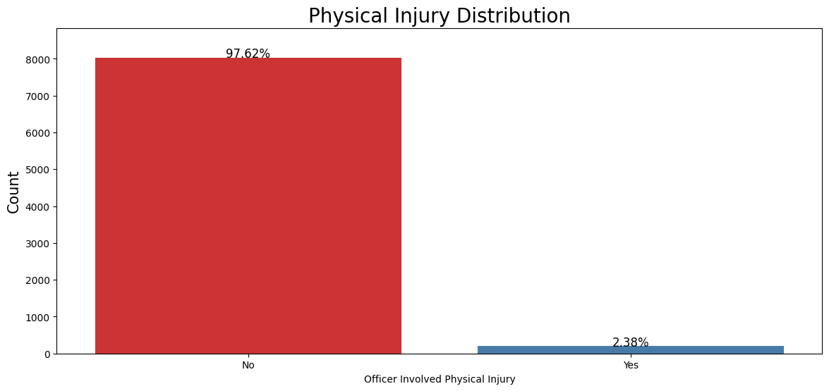
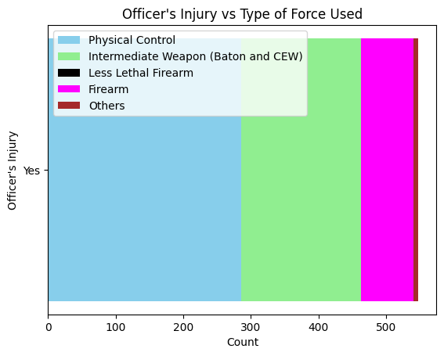
Officer’s Injury and Type of Force Used

Slide 24
Summary
Firearm is the most common use of force for both individuals and animals.
Use of force is mainly for people of age range between 25-44 years old.
There’s no distinct trend of the effect of race on type of force used.
For the effect of incident type, the more violent is the crime, the more firearm is used.
As the number of the team of officers increases, use of force decreases in all categories.
More use of force is being used in residential buildings but the type of location does not enforce the type of force used.
Nature of incident is the most important factor in influencing the officer’s response of the type of force he/she uses.
For incidents involving fatality, the firearm is the main type of force; however, injury of the individuals and officers, both, mainly happen during physical control and use of intermediate weapons.

Slide 25
Thank You! Any Questions?

Slide 26
Use of Force

Slide 27
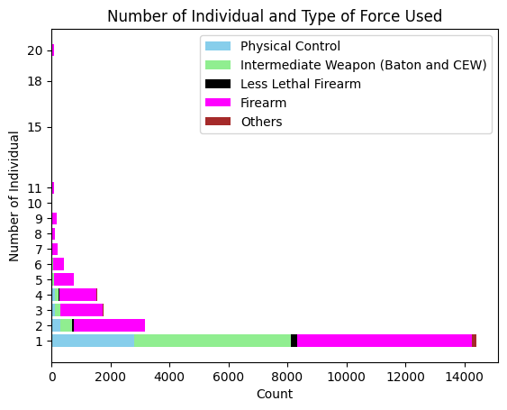
Use of Force

